Slide 1
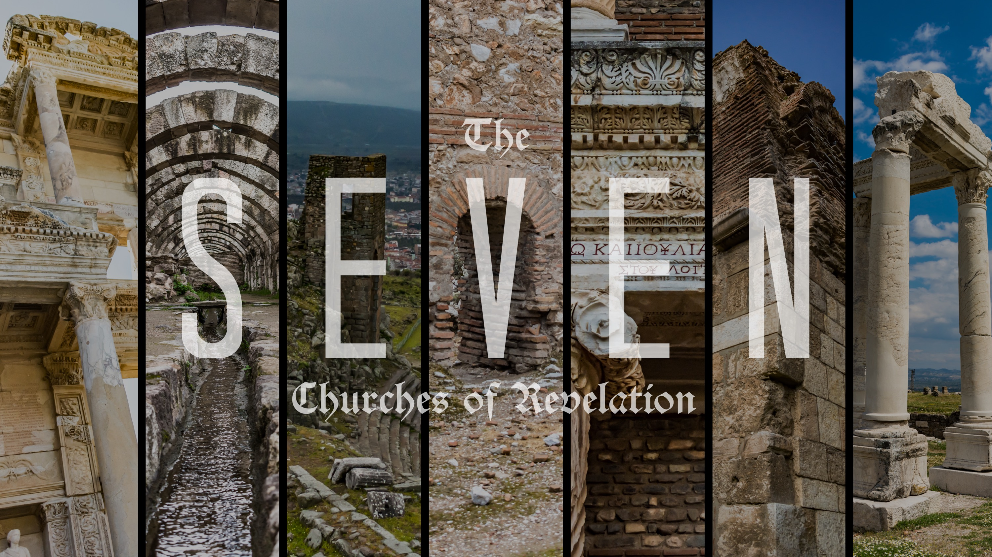

Slide 2
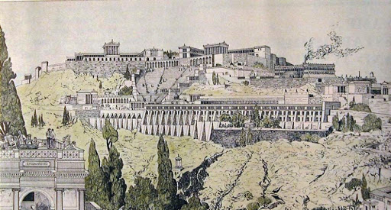
A Faithful Witness
The Church in Pergamum

Slide 3
Revelation 2:12-17
12 “And to the angel of the church in Pergamum write: ‘The words of him who has the sharp two-edged sword.” 13 “‘I know where you dwell, where Satan's throne is. Yet you hold fast my name, and you did not deny my faith[ even in the days of Antipas my faithful witness, who was killed among you, where Satan dwells. 14 But I have a few things against you: you have some there who hold the teaching of Balaam, who taught Balak to put a stumbling block before the sons of Israel, so that they might eat food sacrificed to idols and practice sexual immorality.

Slide 4
Revelation 2:12-17
15 So also you have some who hold the teaching of the Nicolaitans. 16 Therefore repent. If not, I will come to you soon and war against them with the sword of my mouth. 17 He who has an ear, let him hear what the Spirit says to the churches. To the one who conquers I will give some of the hidden manna, and I will give him a white stone, with a new name written on the stone that no one knows except the one who receives it.’

Slide 5
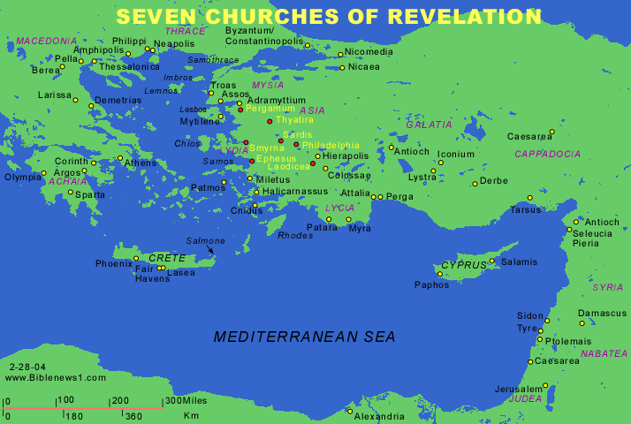
Pergamum

Slide 6
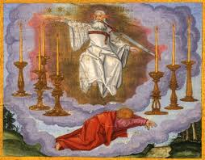
V2 - “And to the angel of the church in Pergamum write: ‘The words of him who has the sharp two-edged sword.”
V16 – “Therefore repent. If not, I will come to you soon and war against them with the sword of my mouth.”
1:16 - In his right hand he held seven stars (Ephesus, Sardis), from his mouth came a sharp two-edged sword (Pergamum)…

Slide 7
Hebrews 4: 12-13 For the word of God is living and active, sharper than any two-edged sword, piercing to the division of soul and of spirit, of joints and of marrow, and discerning the thoughts and intentions of the heart. And no creature is hidden from his sight, but all are naked and exposed to the eyes of him to whom we must give account.

Slide 8
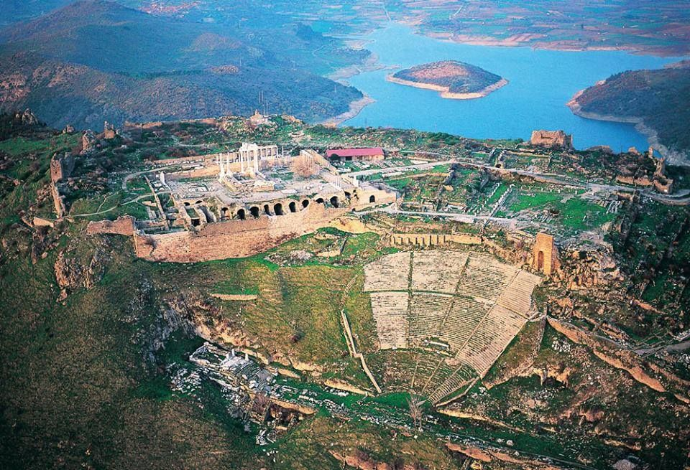
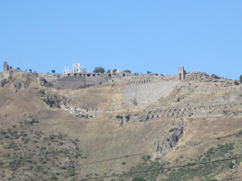
Pergamum
V13 - “I know where you live - where Satan's throne is!”

Slide 9
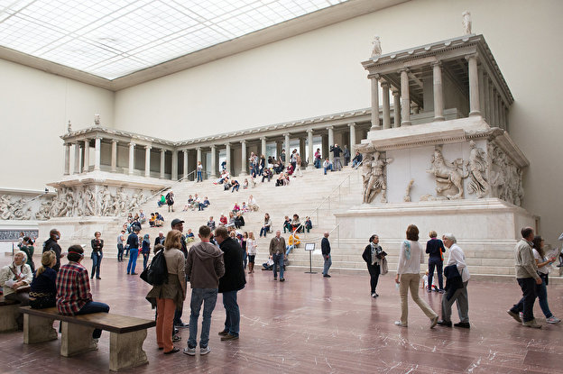
V13 - Yet you hold fast my name, and you did not deny my faith even in the days of Antipas my faithful witness, who was killed among you, where Satan dwells.

Slide 10
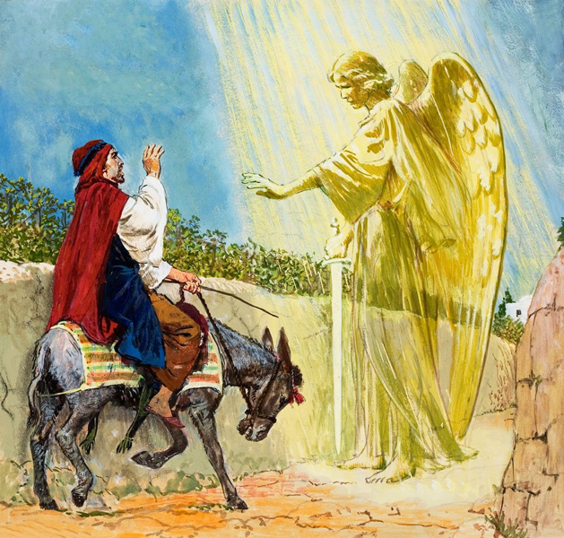
V14-15 - But I have a few things against you: you have some there who hold the teaching of Balaam, who taught Balak to put a stumbling block before the sons of Israel, so
that they might eat food sacrificed
to idols and practice sexual
immorality. So also you have some
who hold the teaching of the
Nicolaitans.

Slide 11
V16 - Therefore repent. If not, I will come to you soon and war against them with the sword of my mouth.
Hebrews 12:5-6
And have you forgotten the exhortation that addresses you as sons?
“My son, do not regard lightly the discipline of the Lord,
nor be weary when reproved by him.
For the Lord disciplines the one he loves,
and chastises every son whom he receives.”

Slide 12
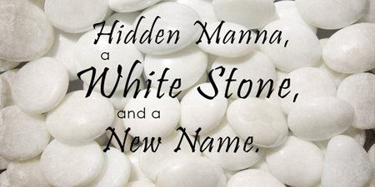
V17 - He who has an ear, let him hear what the Spirit says to the churches. To the one who conquers I will give some of the hidden manna, and I will give him a white stone, with a new name written on the stone that no one knows except the one who receives it.’

