Slide 1
Authentic Christianity
“THE AROMA “

Slide 2
Revelations 2:8
To the angel of the church in Smyrna write: The First and the Last, the One who was dead and came to life, says:

Slide 3
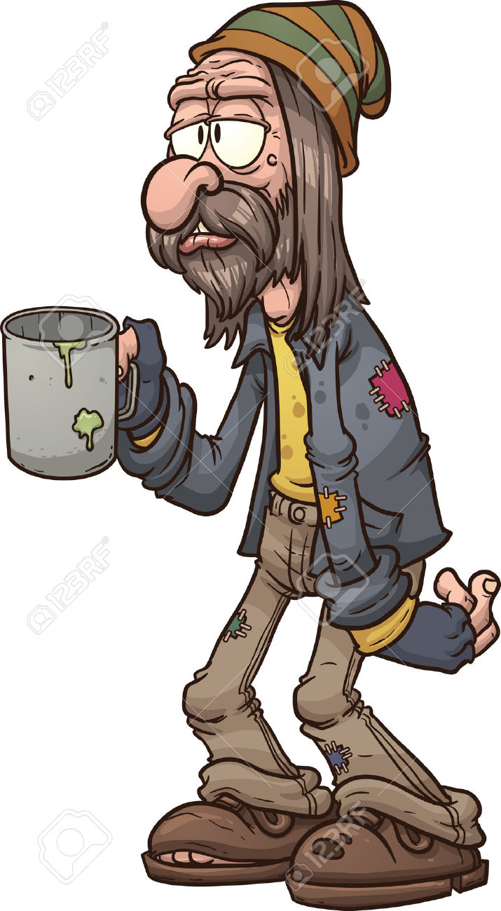
Revelations 2:9
I know your tribulation and poverty, yet you are rich.
James 2:5 “God chose the poor of the
World to be rich in faith and heirs of
the Kingdom that He promised…”

Slide 4
Revelations 2:9 b
I know the slander of those who say they are Jews and are not , but are a synagogue of Satan.

Slide 5
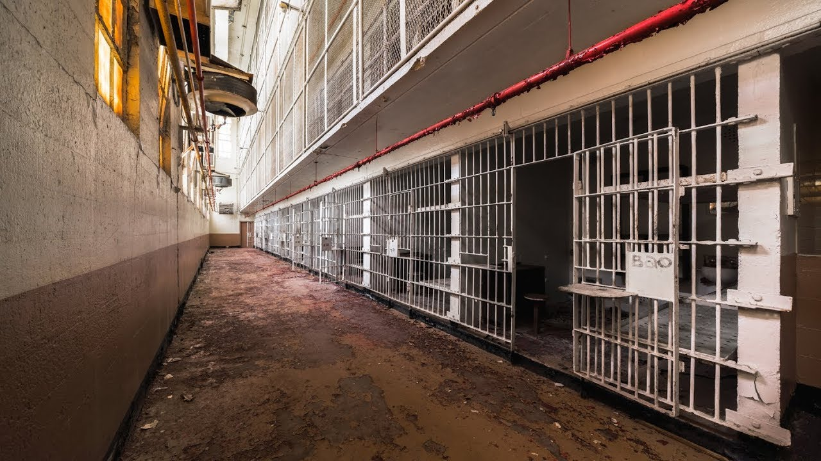
Revelations 2:10
Don’t be afraid of what you are about to suffer. Look, the Devil is about to throw some of you into prison to test you, and you will tribulation for 10 days.

Slide 6
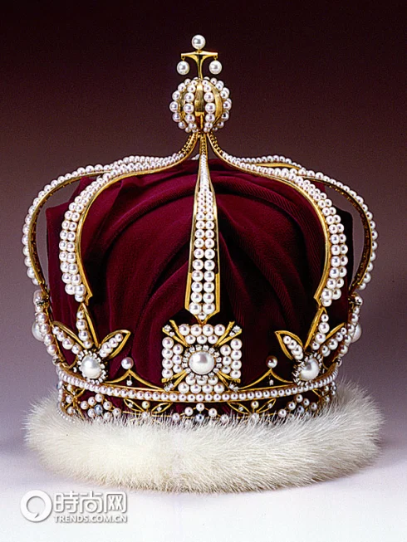
Revelations 2:10 -11
Be faithful until death, and I will give you the crown of life.
Anyone who has an ear should
listen to what the Spirit says to the
Churches..The Victor will Never be
Harmed by the second death.

