Slide 1


Slide 2
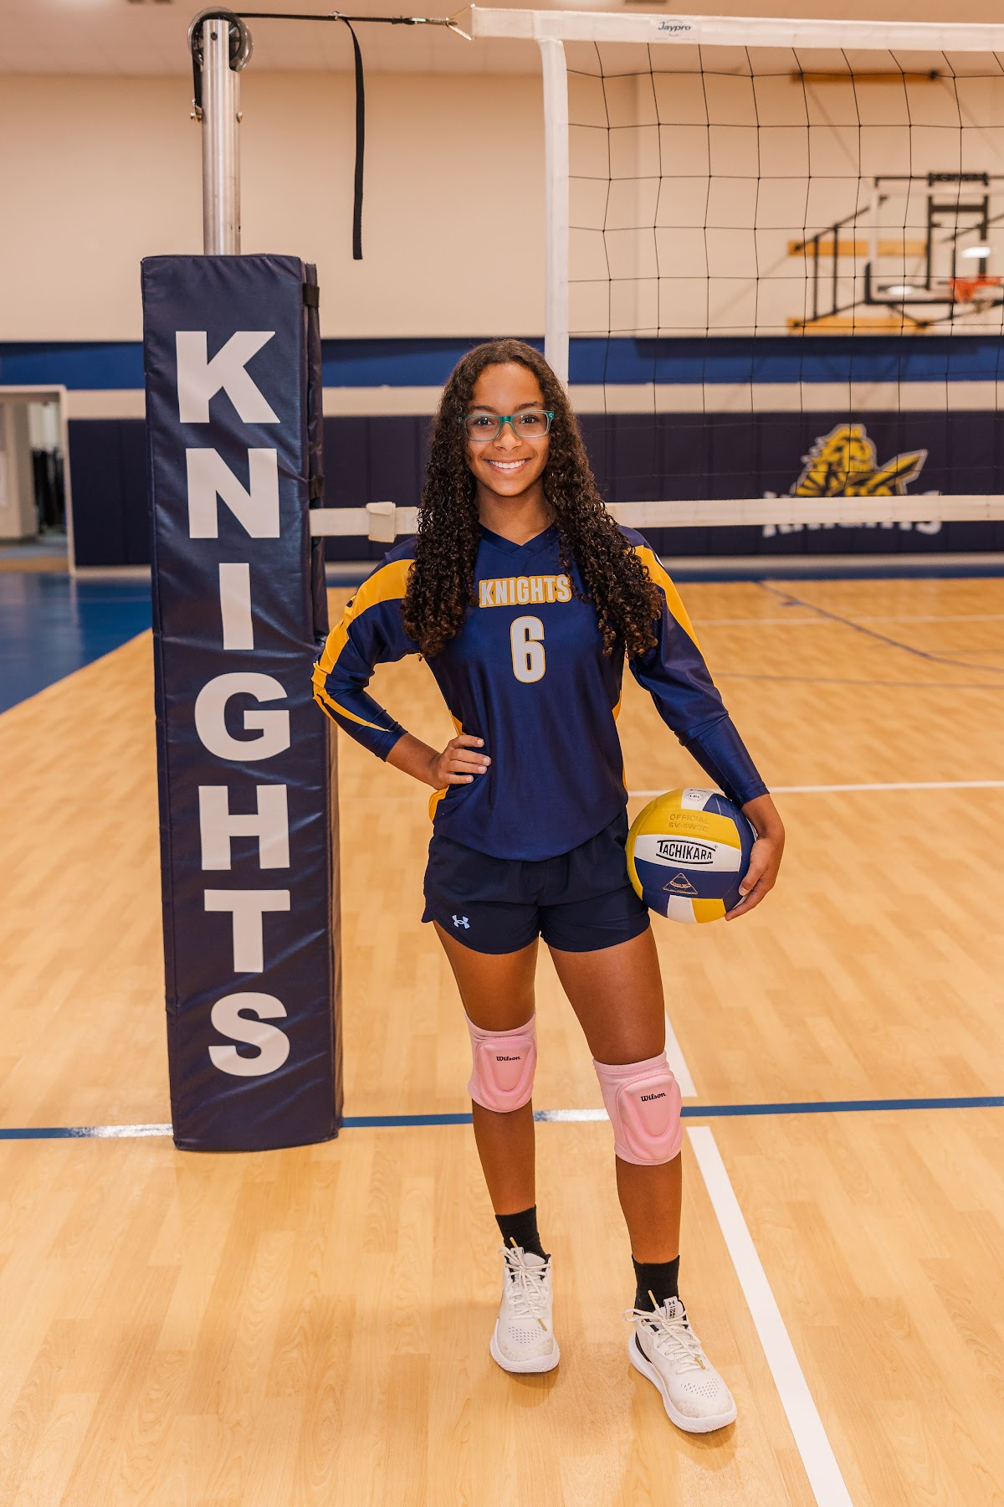
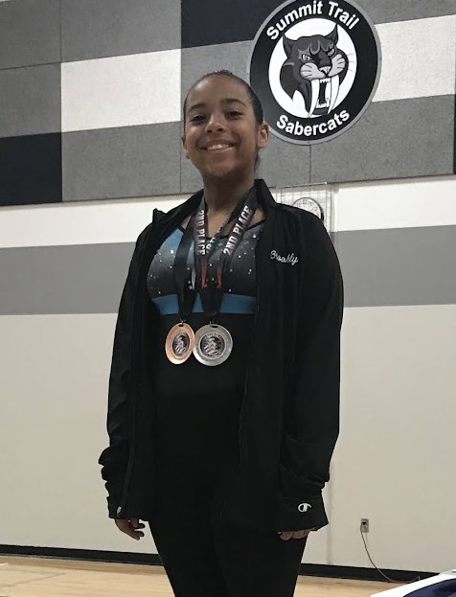
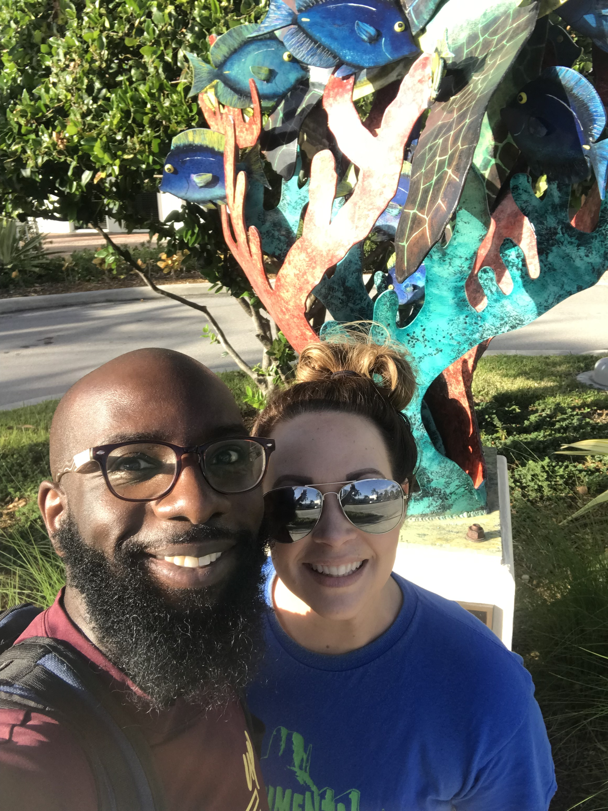
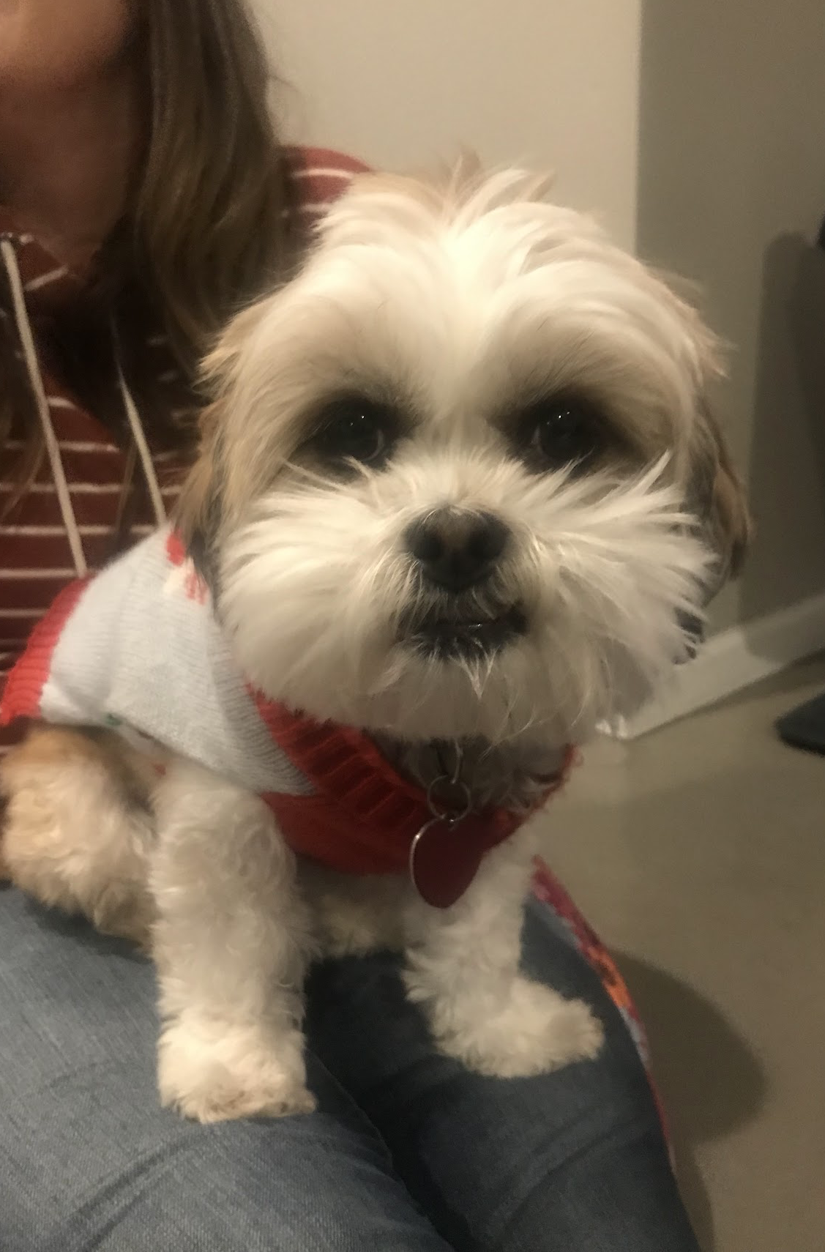

Slide 4
Acts 2:41-47 (NIRV)
41 So those who accepted his message were baptized, and that day about 3,000 people were added to them. 42 And they devoted themselves to the apostles’ teaching, to the fellowship, to the breaking of bread, and to the prayers. 43 Then fear came over everyone, and many wonders and signs were being performed through the apostles. 44 Now all the believers were together and held all things in common.

Slide 5
Acts 2:41-47 (NIRV)
45 They sold their possessions and property and distributed the proceeds to all, as anyone had a need. 46 Every day they devoted themselves to meeting together in the temple complex, and broke bread from house to house. They ate their food with a joyful and humble attitude, 47 praising God and having favor with all the people. And every day the Lord added to them those who were being saved.

Slide 7
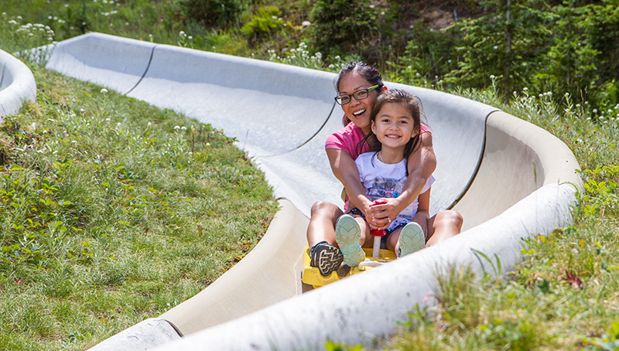

Slide 8
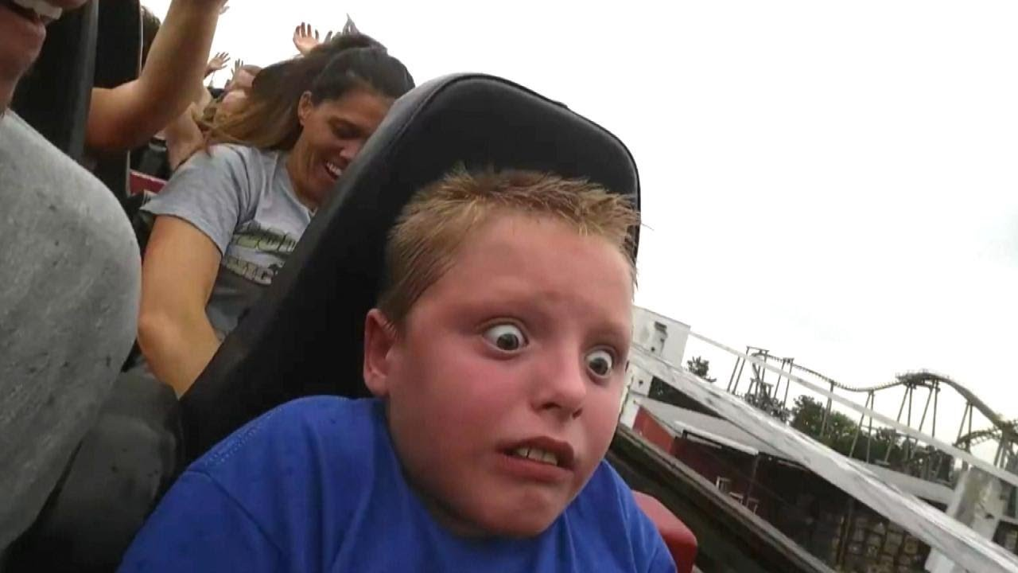

Slide 10
Philippians 1:12-17 (NIRV)
12 Brothers and sisters, here is what I want you to know. What has happened to me has actually helped to spread the good news. 13 One thing has become clear. I am being held by chains because I am a witness for Christ. All the palace guards and everyone else know it. 14 And because I am a prisoner, most of the believers have become bolder in the Lord. They now dare even more to preach the good news without fear.

Slide 11
Philippians 1:12-16 (NIRV)
15 It’s true that some preach about Christ because they are jealous. But others preach about Christ to help me in my work. 16 The last group acts out of love. They know I have been put here to be a witness for the good news.

Slide 13
Philippians 1:18-20 (NIRV)
18 But what does it matter? Here is the important thing. Whether for right or wrong reasons, Christ is being preached about. That makes me very glad. And I will continue to be glad. 19 I know that you are praying for me. I also know that God will give me the Spirit of Jesus Christ to help me. So no matter what happens, I’m sure I will still be set free.

Slide 14
Philippians 1:18-21 (NIRV)
20 I completely expect and hope that I won’t be ashamed in any way. I’m sure I will be brave enough. Now as always Christ will receive glory because of what happens to me. He will receive glory whether I live or die. 21 For me, life finds all its meaning in Christ. Death also has its benefits.

Slide 16
Philippians 2:5-8 (HCSB)
5 Make your own attitude that of Christ Jesus, 6 who, existing in the form of God, did not consider equality with God as something to be used for His own advantage, 7 Instead He emptied Himself by assuming the form of a slave, taking on the likeness of men. And when He had come as a man in His external form, 8 He humbled Himself by becoming obedient to the point of death— even to death on a cross.

Slide 18
Genesis 2:8-9 (HCSB)
8 The Lord God planted a garden in Eden, in the east, and there He placed the man He had formed. 9 The Lord God caused to grow out of the ground every tree pleasing in appearance and good for food, including the tree of life in the middle of the garden, as well as the tree of the knowledge of good and evil.

Slide 19
Genesis 3:1-5 (HCSB)
1 Now the serpent was the most cunning of all the wild animals that the Lord God had made. He said to the woman, “Did God really say, ‘You can’t eat from any tree in the garden’?” 2 The woman said to the serpent, “We may eat the fruit from the trees in the garden. 3 But about the fruit of the tree in the middle of the garden, God said, ‘You must not eat it or touch it, or you will die.’”

Slide 20
Genesis 3:1-5 (HCSB)
4 “No! You will not die,” the serpent said to the woman. 5 “In fact, God knows that when you eat it your eyes will be opened and you will be like God, knowing good and evil.”

Slide 22
How will you risk your heart for jesus?

