Slide 1
Jesus “The Life”

Slide 2
John 14:6
6 Jesus told him, “I am the way, the truth, and the life. No one comes to the Father except through Me.

Slide 3
John 14:5
5 “Lord,” Thomas said, “we don’t know where You’re going. How can we know the way?”

Slide 4
John 14:1-6
“Your heart must not be troubled. Believe[a] in God; believe also in Me. 2 In My Father’s house are many dwelling places;[b] if not, I would have told you. I am going away to prepare a place for you. 3 If I go away and prepare a place for you, I will come back and receive you to Myself, so that where I am you may be also. 4 You know the way to where I am going.”[c]
5 “Lord,” Thomas said, “we don’t know where You’re going. How can we know the way?”
6 Jesus told him, “I am the way, the truth, and the life. No one comes to the Father except through Me.

Slide 5
John 13:36-38
36 “Lord,” Simon Peter said to Him, “where are You going?”
Jesus answered, “Where I am going you cannot follow Me now, but you will follow later.”
37 “Lord,” Peter asked, “why can’t I follow You now? I will lay down my life for You!”
38 Jesus replied, “Will you lay down your life for Me? I assure you: A rooster will not crow until you have denied Me three times.

Slide 6
Jesus last discourse (13:31-14:31)
(13:21-30) prediction of betrayal by Judas
(13:31-14:31) Questions and answers
(John 13:31-35) The new commandment
(John 13:36-14:4) Peter’s question
(John 14:5-7) Thomas question
(John 14:8-15) Phillips request
(John 14:16-21) The promise from Jesus of the Holy Spirit...

Slide 7


Slide 8
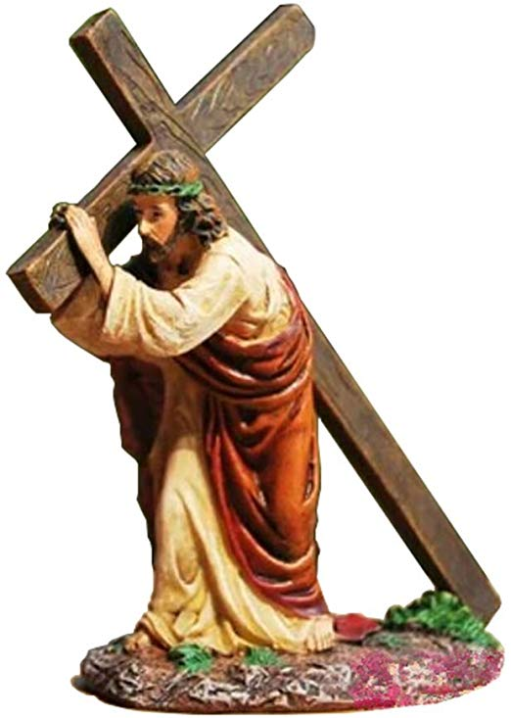
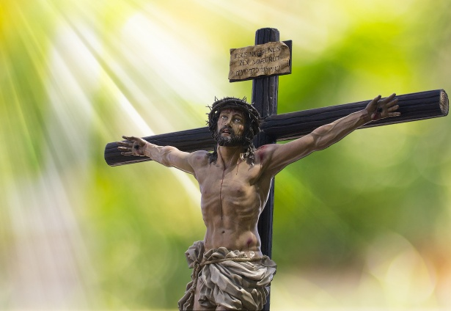

Slide 9
The Way
Only Jesus can provide access to God because he alone paid the penalty for our sins.

Slide 10
The Truth John 5:31
31 “If I testify about Myself, My testimony is not valid.

Slide 11
The Life (John 5:31-47)
Vs
Verse 32 John the Baptist (John 1:6-7)
Vs
Verse 36 The “Works” Jesus did… assigned directly from God
Vs
37 God The Father (Matthew 5:37)
Vs
46 Moses “he wrote about me” (Deuteronomy 18:18-19)

Slide 12
The Life...
Life
  The state of one who s possessed of vitality or is animate.

Slide 13
John 1:4
4 Life was in Him, and that life was the light of men.

Slide 14
John 1:1-5
In the beginning was the Word,[a]and the Word was with God,and the Word was God.2 He was with God in the beginning.3 All things were created through Him, and apart from Him not one thing was createdthat has been created.4 Life was in Him,[b]and that life was the light of men.5 That light shines in the darkness,yet the darkness did not overcome[c] it.

Slide 15
John 5:26
26 For just as the Father has life in Himself, so also He has granted to the Son to have life in Himself.

Slide 16
Jesus IS the revelation of God in human form….
Eternal/Forever
Not subject to death
Made death to subject to Him
Jesus death demonstrates his power and continuity (Consistent existence) of His Life

Slide 17
Light and the Light of Men (humanity)
Light
-Emitted by a lamp
-A heavenly light such as surrounds angels when they appear on earth
God is light because light has the extremely delicate, subtle, pure, brilliant quality
Of truth and its knowledge, together with the spiritual purity associated with it
That which is exposed to the view of all, openly, publicly
Reason, mind
The power of understanding especially more and spiritual truth.

Slide 18
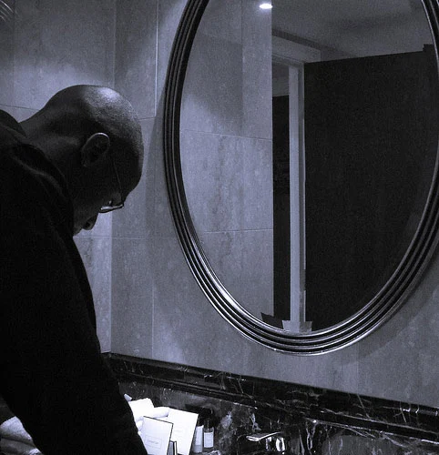
We are a reflection of something…
Regardless of how we intellectually view God
Our lives reveal a certain “truth”

Slide 19
Life...
Life real and genuine, a life active and vigorous, devoted to God, blessed, in the portion even in this world of those who put their trust in christ, but after the resurrection to e consummated by new accessions (among them a more perfect body), and to last forever.
What does you life radiate Light or Darkness?

Slide 20
Hebrews 12:1-3
Therefore, since we also have such a large cloud of witnesses surround us, let us lay aside every weight and the sin that so easily ensnares us. Let us run with endurance the race that lies before us, 2 keeping our eyes on Jesus, the source and perfecter of our faith, who for the joy that lay before Him endured a cross and despised the shame and has sat down at the right hand of God’s throne.3 For consider Him who endured such hostility from sinners against Himself, so that you won’t grow weary and lose heart.

