Slide 1
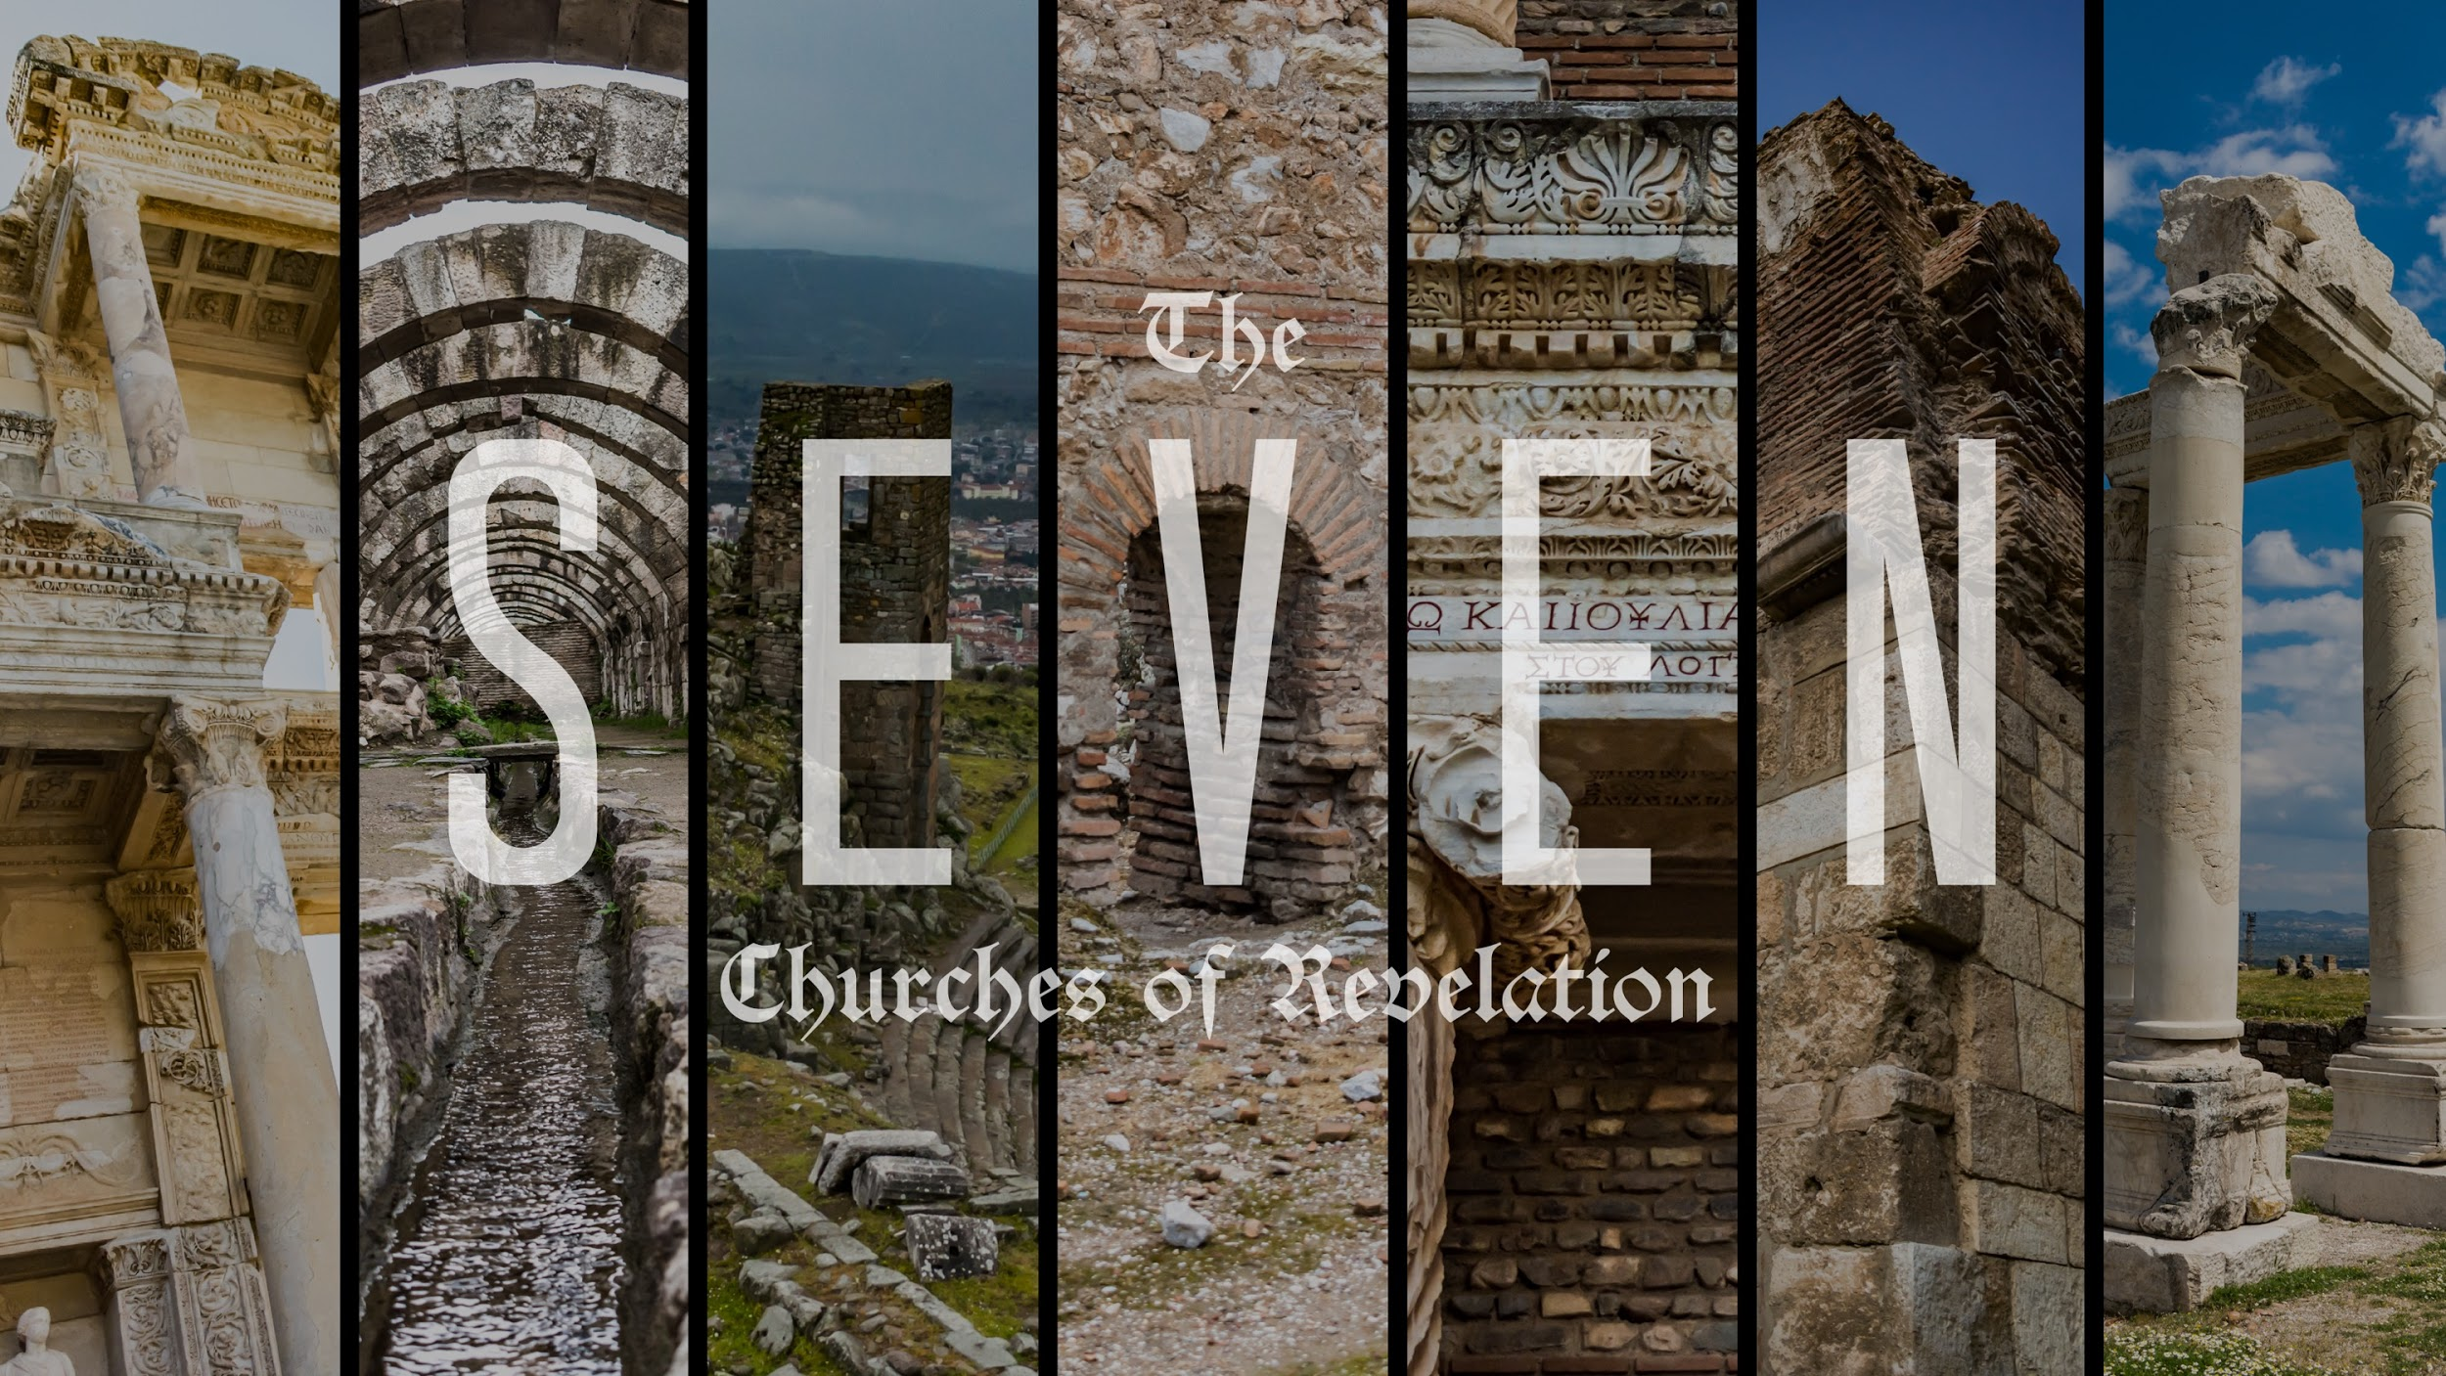

Slide 2
Revelation 3:7-9 ESV
7 “And to the angel of the church in Philadelphia write: ‘The words of the holy one, the true one, who has the key of David, who opens and no one will shut, who shuts and no one opens. 8 “‘I know your works. Behold, I have set before you an open door, which no one is able to shut. I know that you have but little power, and yet you have kept my word and have not denied my name. 9 Behold, I will make those of the synagogue of Satan who say that they are Jews and are not, but lie—behold, I will make them come and bow down before your feet, and they will learn that I have loved you.

Slide 3
"Probably it is admission to the city of David, the heavenly Jerusalem, that is in mind, and this Christ alone gives and withholds."
- Dr. Leon Morris

Slide 4
Revelation 3:10 ESV
10 Because you have kept my word about patient endurance, I will keep you from the hour of trial that is coming on the whole world, to try those who dwell on the earth.

Slide 5
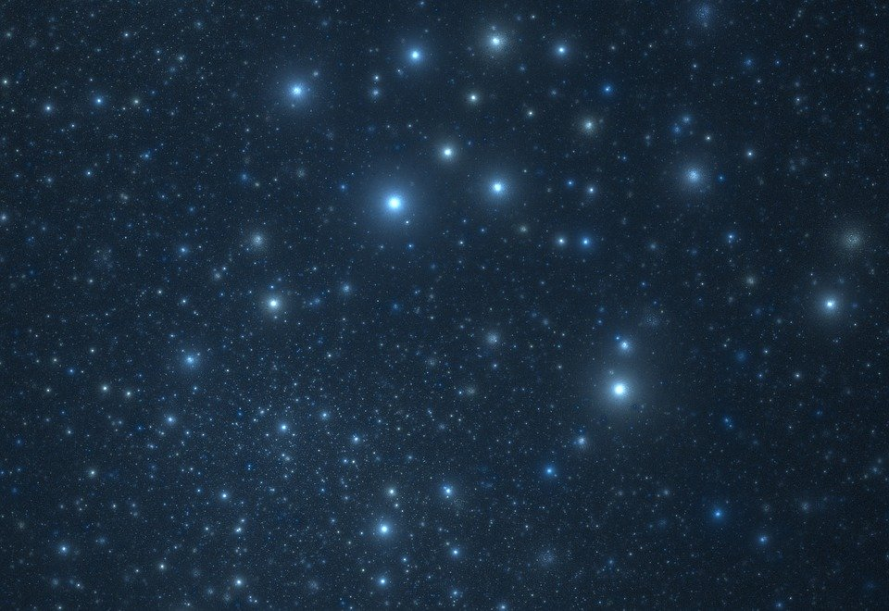
Philadelphia:
The Church of
Patient Endurance

Slide 6
Revelation 1:9 ESV
⁹ I, John, your brother and partner in the tribulation and the kingdom and the patient endurance that are in Jesus, was on the island called Patmos on account of the word of God and the testimony of Jesus.

Slide 7
Revelation 14:12-13 NET
¹² This requires the steadfast (patient) endurance of the saints—those who obey God’s commandments and hold to their faith in Jesus. ¹³ Then I heard a voice from heaven say, “Write this: ‘Blessed are the dead,those who die in the Lord from this moment on!’” “Yes,” says the Spirit, “so they can rest from their hard work, because their deeds will follow them.”

Slide 8

In Jesus

Slide 9
James 1:2-4 NET
[2] My brothers and sisters, consider it nothing but joy when you fall into all sorts of trials, [3] because you know that the testing of your faith produces endurance. [4] And let endurance have its perfect effect, so that you will be perfect (mature) and complete, not deficient in anything.

Slide 10
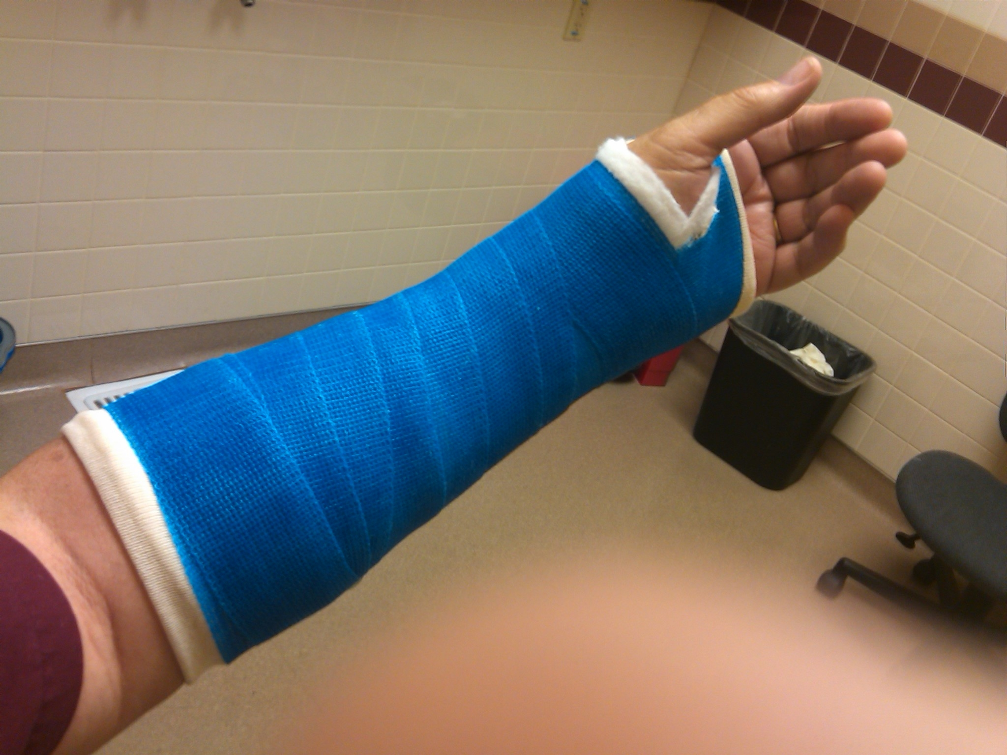

Slide 11
James 5:10-11 NET
[10] As an example of suffering and patience, brothers and sisters, take the prophets who spoke in the Lord's name. [11] Think of how we regard as blessed those who have endured. You have heard of Job’s endurance and you have seen the Lord’s purpose, that the Lord is full of compassion and mercy.

Slide 12
Job’s Sufferings:
Lost his property Job 1:13-17
Lost his children Job 1:18-19
Lost his health Job 2:7-8
Lost his wife's backing Job 2:9
Lack of sympathy 16:1-3
Lost his friends 30:1-10

Slide 13
“A Christian will part with anything rather than his hope; he knows that hope will keep the heart both from aching and breaking, from fainting and sinking; he knows that hope is a beam of God, a spark of glory, and that nothing shall extinguish it till the soul be filled with glory.” - Thomas Brooks

Slide 14
Romans 5: 1-5 NET
5 Therefore, since we have been declared righteous by faith, we have peace with God through our Lord Jesus Christ, 2 through whom we have also obtained access into this grace in which we stand, and we rejoice in the hope of God’s glory. 3 Not only this, but we also rejoice in sufferings, knowing that suffering produces endurance,

Slide 15
4 and endurance, character, and character, hope. 5 And hope does not disappoint, because the love of God has been poured out in our hearts through the Holy Spirit who was given to us.

Slide 16

The Hope Cycle
HOPE
CHARACTER
SUFFERING
ENDURANCE

Slide 17
"You and I are unavoidably and irreducibly hope-based creatures.
We are controlled not how we live now, but what we think will happen later. Christian hope has to do with the ultimate future, not the immediate."
- Tim Keller

Slide 18
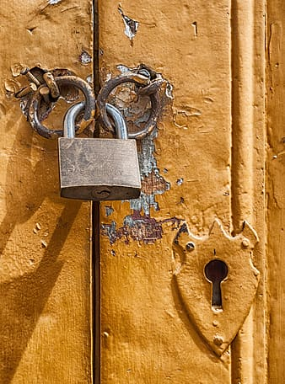
Endurance is a big part of what produces hope and hope in Jesus is crucial for every person that would follow Jesus!

Slide 19
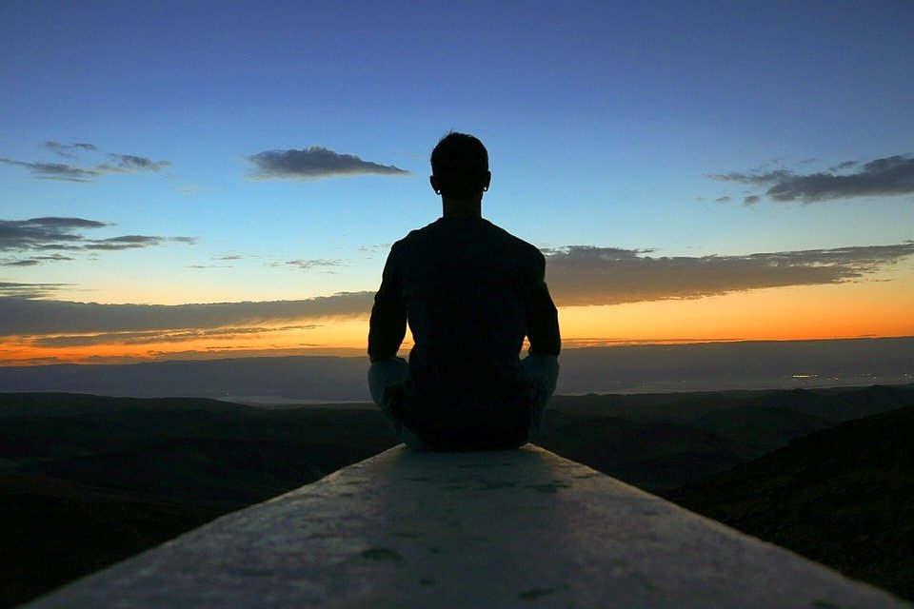
It's this ironclad hope that puts the patience in patient endurance.

Slide 20
Revelation 3:11-13 ESV
11 I am coming soon. Hold fast what you have, so that no one may seize your crown. 12 The one who conquers, I will make him a pillar in the temple of my God. Never shall he go out of it, and I will write on him the name of my God, and the name of the city of my God, the new Jerusalem, which comes down from my God out of heaven, and my own new name. 13 He who has an ear, let him hear what the Spirit says to the churches.’

Slide 21
Philadelphia:
The Church of
Patient Endurance
'How can I grow in my patient endurance?'

Slide 22
