Slide 1
THANKFUL FOR THE STRUGGLE

Slide 2
HEBREWS 12:1
Therefore, since we are surrounded by such a great cloud of witnesses, let us throw off everything that hinders and the sin that so easily entangles. And let us run with perseverance the race marked out for us, fixing our eyes on Jesus, the pioneer and perfecter of faith. For the joy set before him he endured the cross, scorning its shame, and sat down at the right hand of the throne of God.

Slide 3
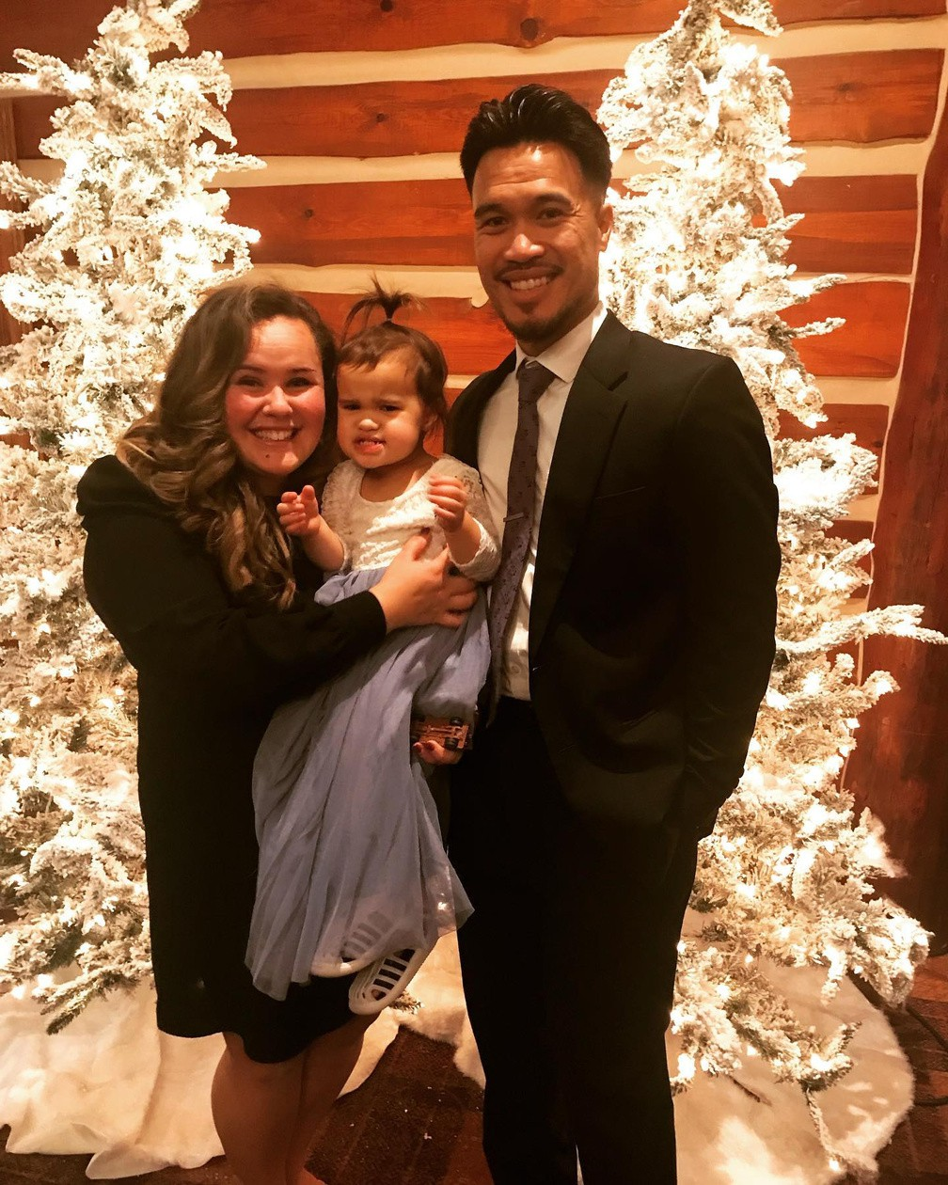

Slide 4

HEBREWS 12:3
Consider him who endured such opposition from sinners, so that you will not grow weary and lose heart.

Slide 5

Hebrews 12:3
1-CONSIDER JESUS

Slide 6
HEBREWS 12:4-6
In your struggle against sin, you have not yet resisted to the point of shedding your blood. 5 And have you completely forgotten this word of encouragement that addresses you as a father addresses his son? It says,
“My son, do not make light of the Lord’s discipline, and do not lose heart when he rebukes you, because the Lord disciplines the one he loves, and he chastens everyone he accepts as his son.”[a]

Slide 7
HEBREWS 12:7-9
Endure hardship as discipline; God is treating you as his children. For what children are not disciplined by their father? If you are not disciplined—and everyone undergoes discipline—then you are not legitimate, not true sons and daughters at all. Moreover, we have all had human fathers who disciplined us and we respected them for it. How much more should we submit to the Father of spirits and live!

Slide 8
HEBREWS 12:10-11
They disciplined us for a little while as they thought best; but God disciplines us for our good, in order that we may share in his holiness. No discipline seems pleasant at the time, but painful. Later on, however, it produces a harvest of righteousness and peace for those who have been trained by it.

Slide 9

Hebrews 12:7
2-TRAIN WITH JESUS

Slide 10
