Slide 1
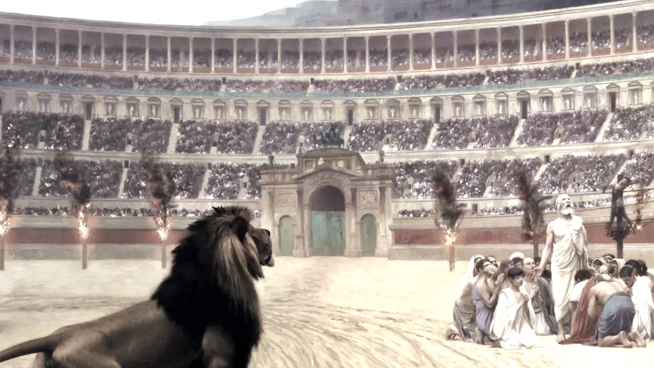
THE WORLD WAS NOT WORTHY OF THEM
(BRUNO OCHMAN LUSTOZA)

Slide 2
The world cannot hate you, but it hates me because I testify that what it does is evil.
JOHN 7:7
NVI

Slide 3
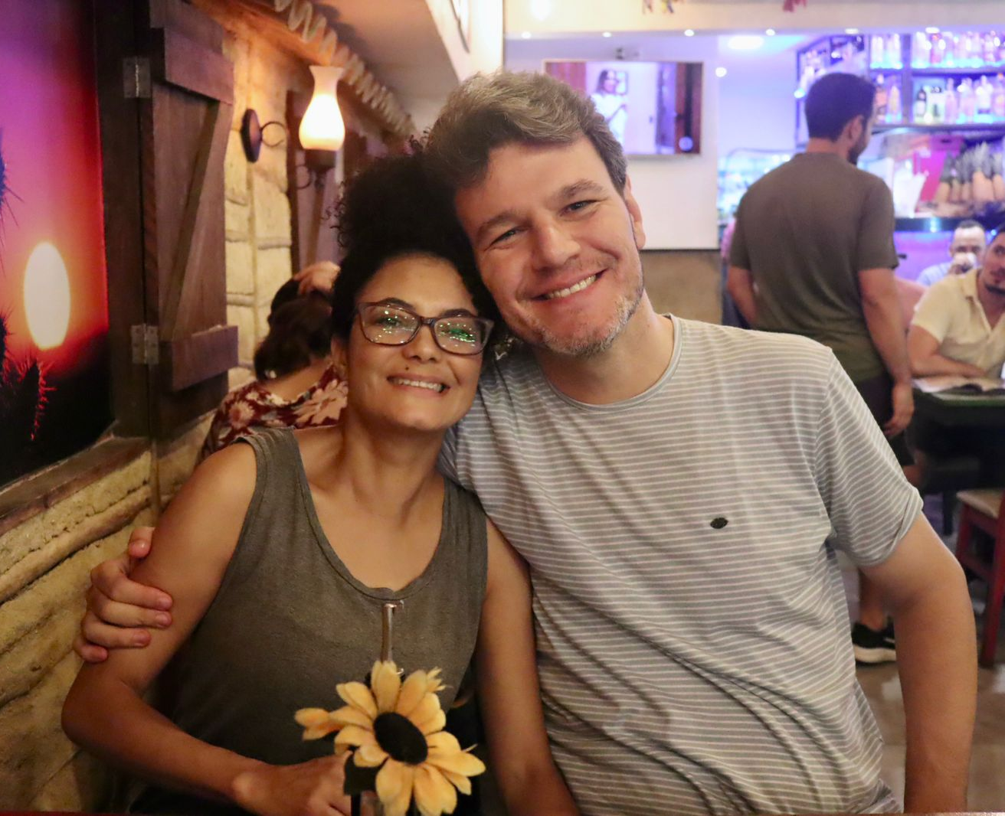

Slide 4
By faith Noah, when warned about things not yet seen, in holy fear built an ark to save his family. By his faith he condemned the world and became heir of the righteousness that is in keeping with faith.
HEBREWS 11:7
NVI

Slide 5
By faith Abraham, when called to go to a place he would later receive as his inheritance, obeyed and went, even though he did not know where he was going. By faith he made his home in the promised land like a stranger in a foreign country; he lived in tents, as did Isaac and Jacob, who were heirs with him of the same promise. For he was looking forward to the city with foundations, whose architect and builder is God.
HEBREWS 11:8-10
NVI

Slide 6
And what more shall I say? I do not have time to tell about Gideon, Barak, Samson and Jephthah, about David and Samuel and the prophets, who through faith conquered kingdoms, administered justice, and gained what was promised; who shut the mouths of lions, quenched the fury of the flames, and escaped the edge of the sword; whose weakness was turned to strength; and who became powerful in battle and routed foreign armies.
HEBREWS 11:32-34
NVI

Slide 7
Women received back their dead, raised to life again. There were others who were tortured, refusing to be released so that they might gain an even better resurrection. Some faced jeers and flogging, and even chains and imprisonment. They were put to death by stoning; they were sawed in two; they were killed by the sword. They went about in sheepskins and goatskins, destitute, persecuted and mistreated—
HEBREWS 11:35-37
NVI

Slide 8
the world was not worthy of them. They wandered in deserts and mountains, living in caves and in holes in the ground.
HEBREWS 11:38
NVI

Slide 9
“C3” faith

Slide 10
“C3” faith
Creator
Faith based on

Slide 11
1) Faith in the Creator

Slide 12
Now faith is confidence in what we hope for and assurance about what we do not see. This is what the ancients were commended for. By faith we understand that the universe was formed at God’s command, so that what is seen was not made out of what was visible. (…) And without faith it is impossible to please God, because anyone who comes to him must believe that he exists and that he rewards those who earnestly seek him.
HEBREWS 11:1-3 & 6
NVI

Slide 13
Early in the morning he would sacrifice a burnt offering for each of them, thinking, “Perhaps my children have sinned and cursed God in their hearts.” This was Job’s regular custom.
JOB 1.5
NVI

Slide 14
C3 Challenges
As soon as you wake up, pray (undivided attention) for the next 20 minutes before doing anything else.

Slide 15
“C3” faith
Creator
Faith based on
Celestial City

Slide 16
2) Faith in the Celestial City

Slide 17
All these people were still living by faith when they died. They did not receive the things promised; they only saw them and welcomed them from a distance, admitting that they were foreigners and strangers on earth. People who say such things show that they are looking for a country of their own.
HEBREWS 11:13-14
NVI

Slide 18
If they had been thinking of the country they had left, they would have had opportunity to return. Instead, they were longing for a better country—a heavenly one. Therefore God is not ashamed to be called their God, for he has prepared a city for them.
HEBREWS 11:15-16
NVI

Slide 19
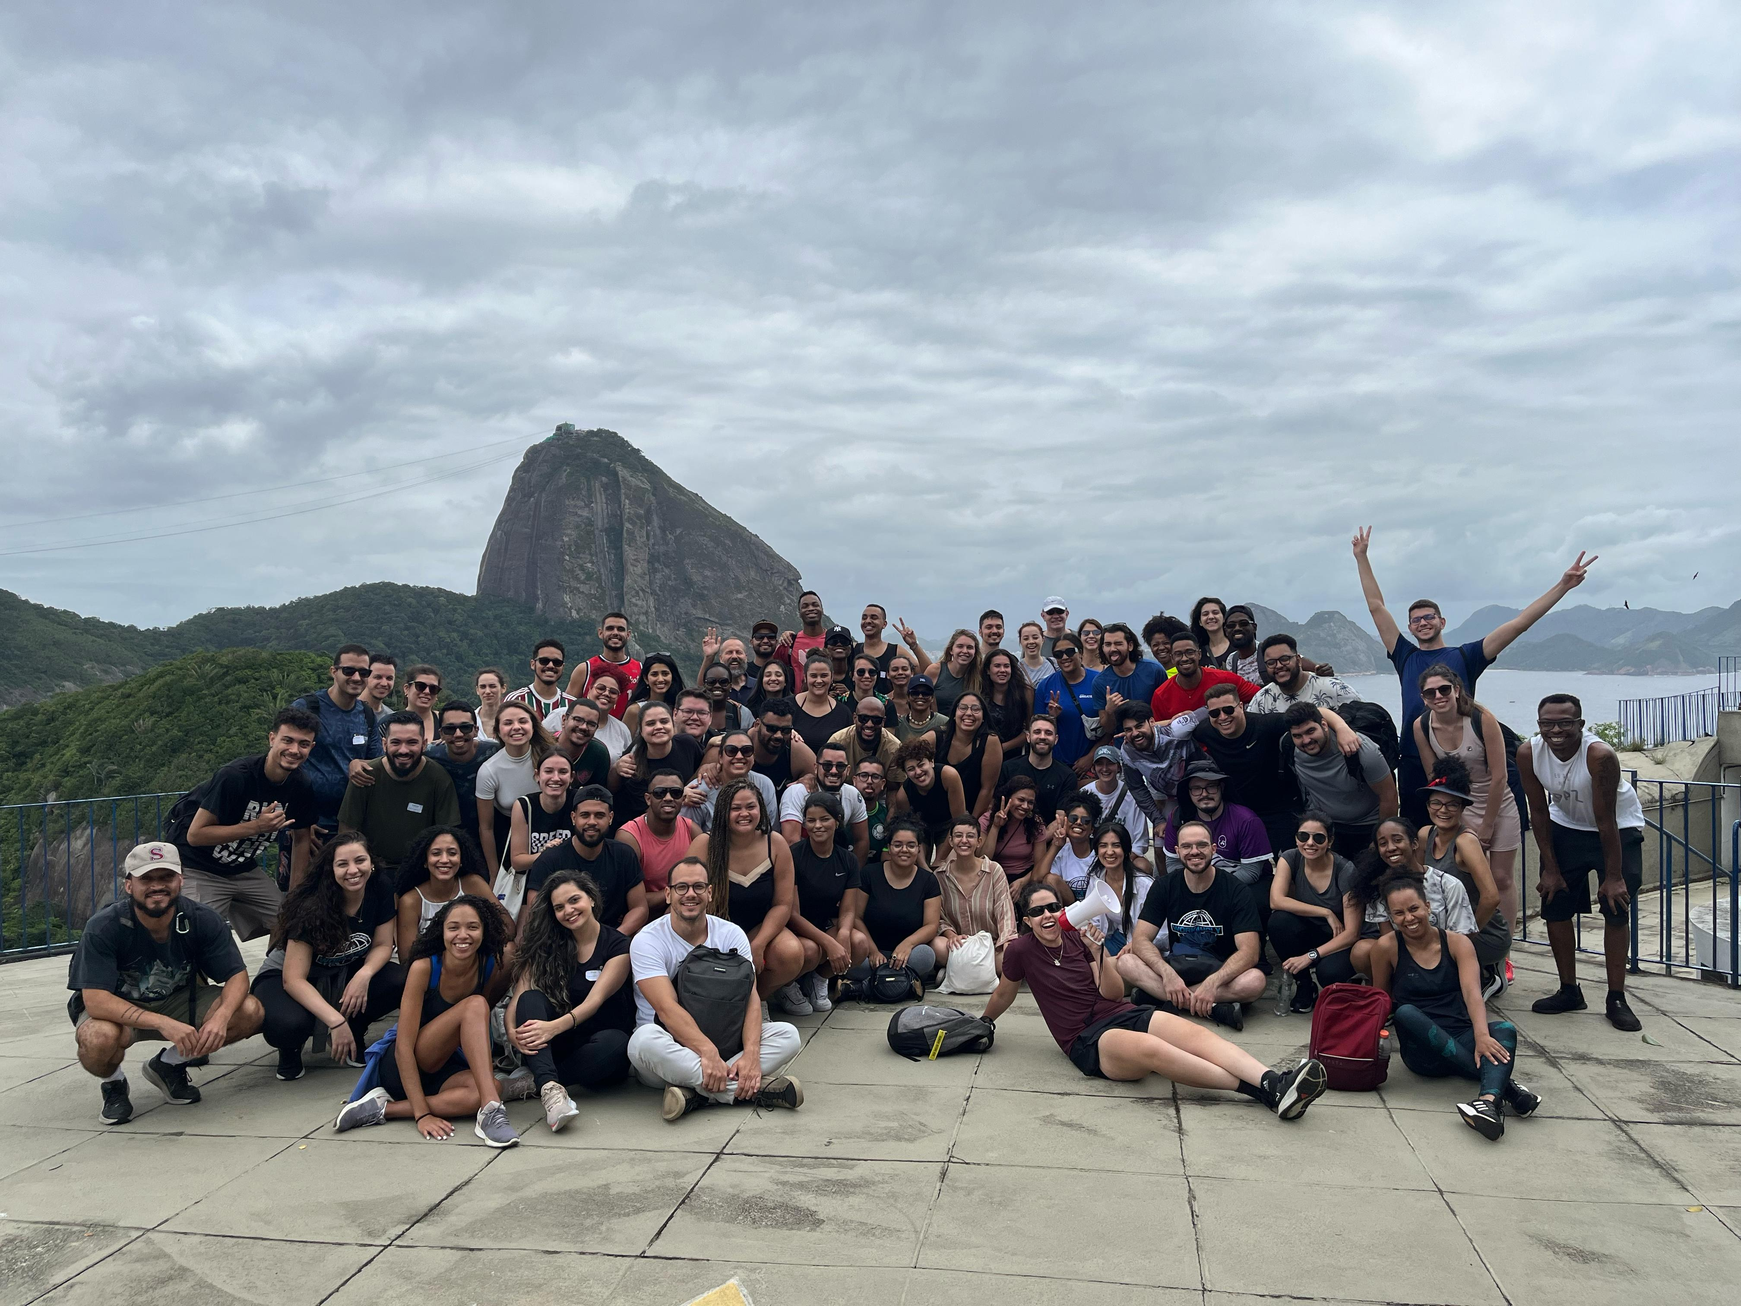


Slide 20
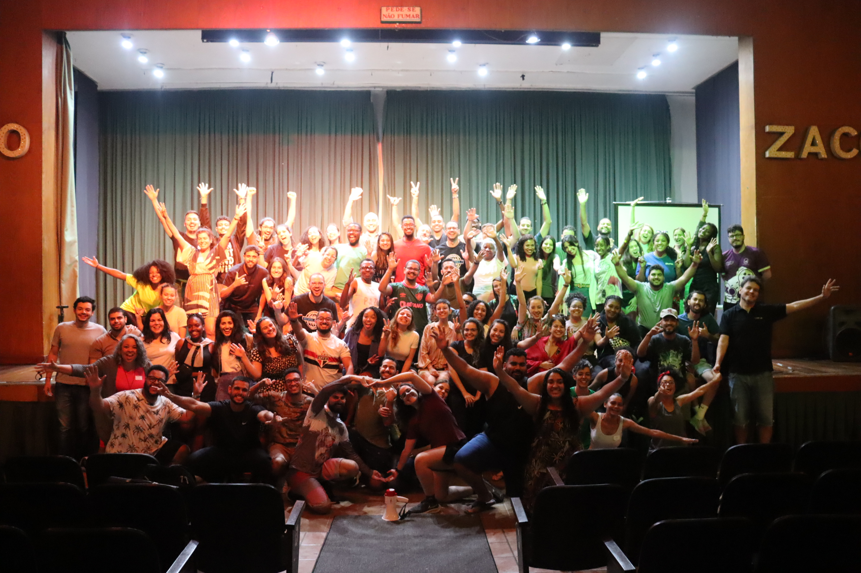

Slide 21
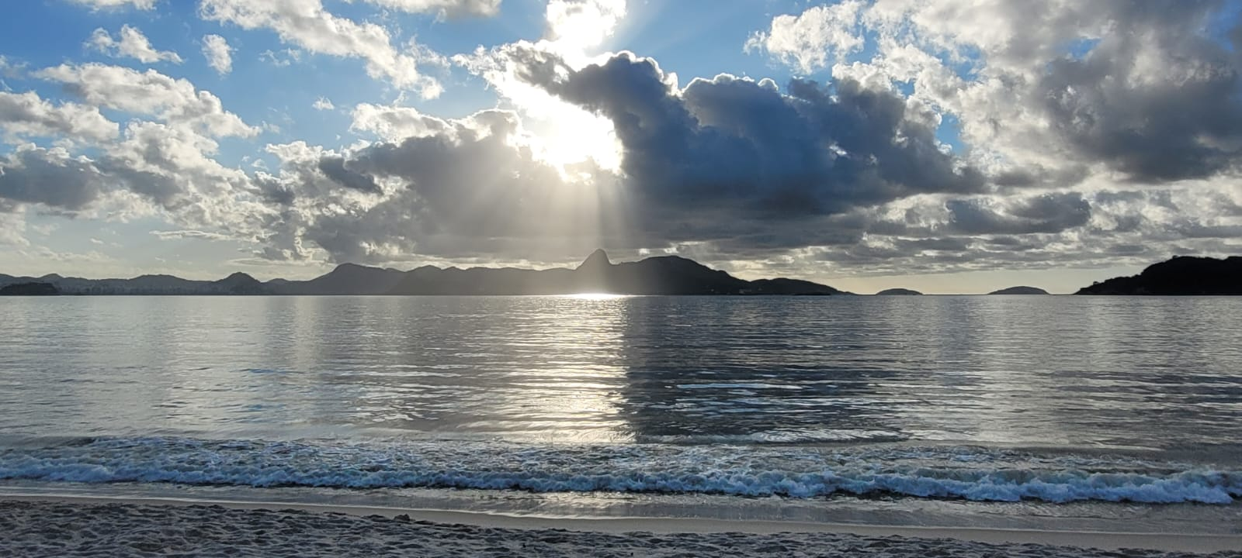

Slide 22
C3 Challenges
As soon as you wake up, pray (undivided attention) for the next 20 minutes before doing anything else.
Practice something that shows less attachment to the world and more faith in things from above (celestial city)

Slide 23
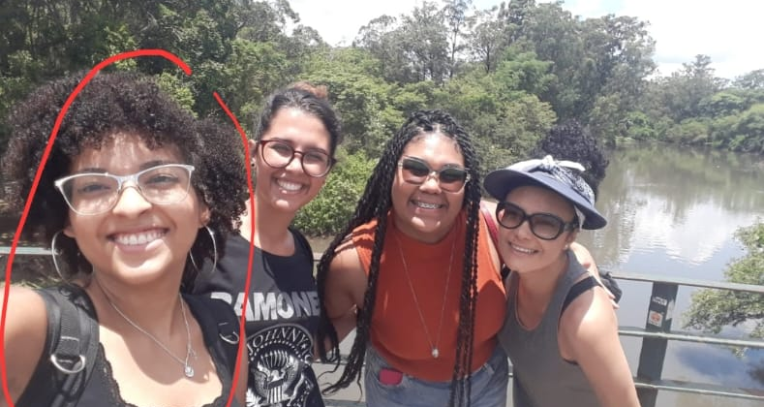
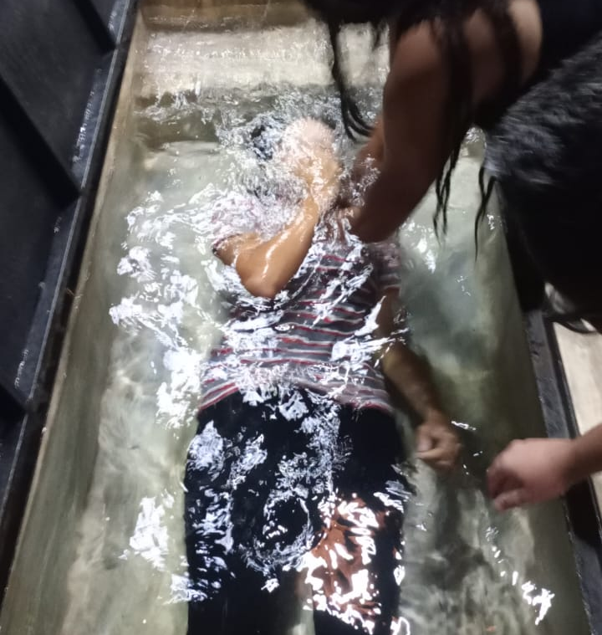
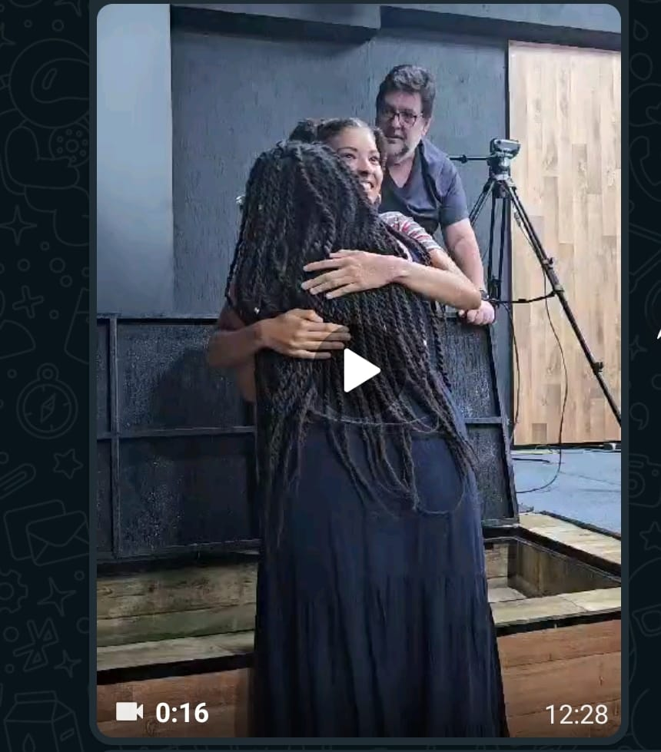
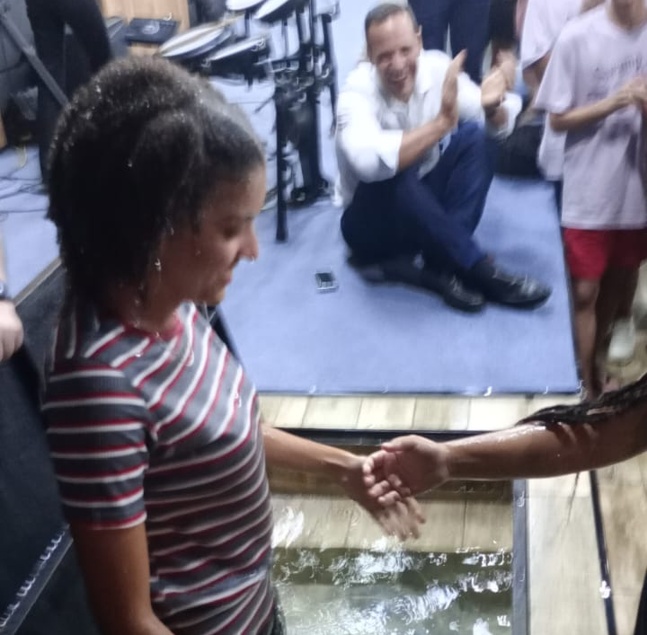

Slide 24
“C3” faith
Creator
Faith based on
Celestial City
Christ Jesus

Slide 25
3) Faith in Christ Jesus

Slide 26
Therefore, since we are surrounded by such a great cloud of witnesses, let us throw off everything that hinders and the sin that so easily entangles. And let us run with perseverance the race marked out for us, fixing our eyes on Jesus, the pioneer and perfecter of faith.
HEBREWS 12.1-2
NVI

Slide 27
For the joy set before him he endured the cross, scorning its shame, and sat down at the right hand of the throne of God. Consider him who endured such opposition from sinners, so that you will not grow weary and lose heart.
HEBREWS 12.2-3
NVI

Slide 28
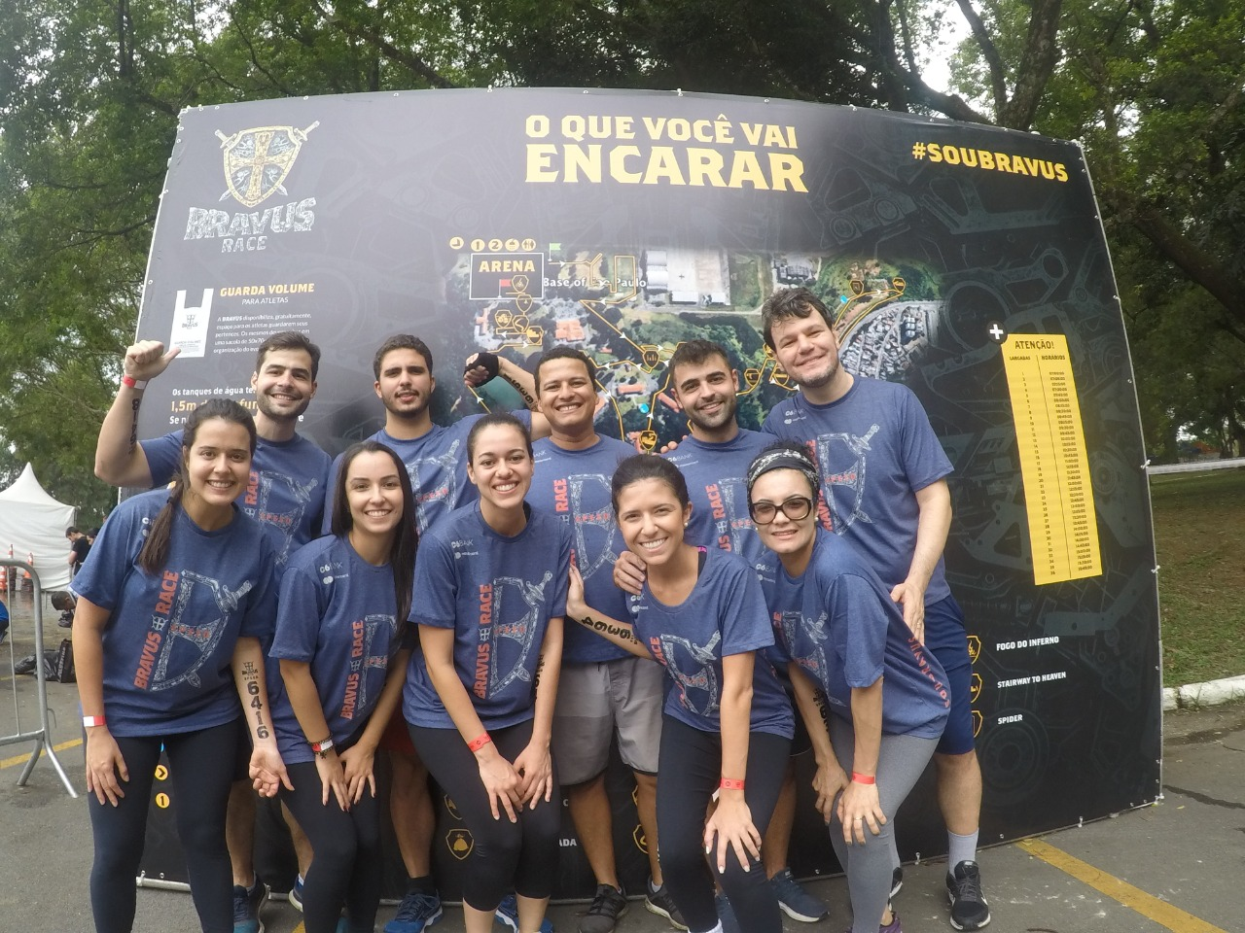

Slide 29
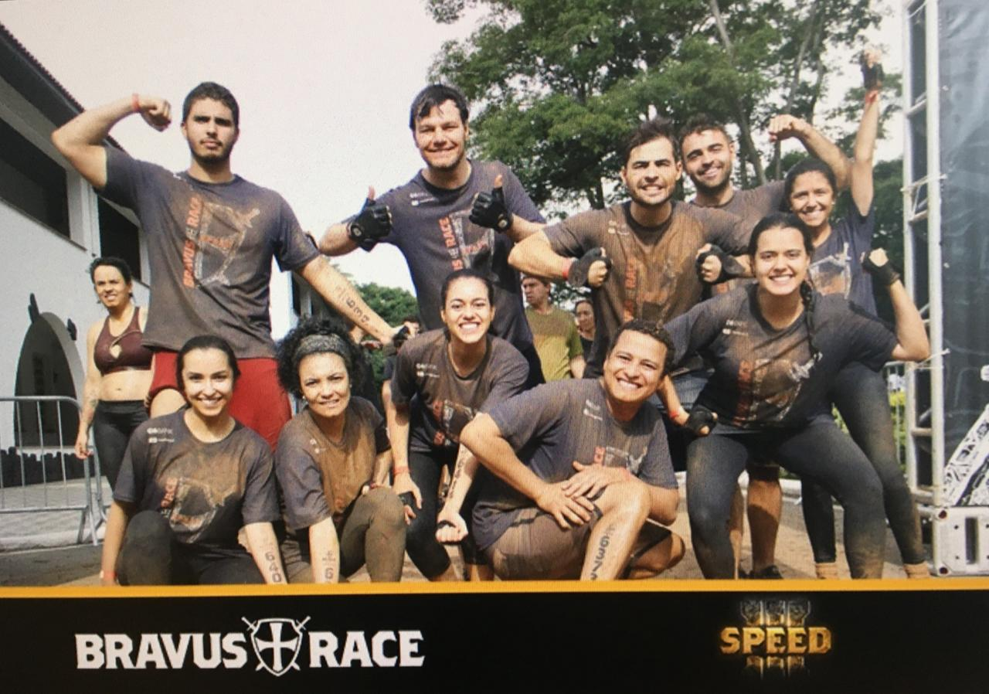

Slide 30
C3 Challenges
As soon as you wake up, pray (undivided attention) for the next 20 minutes before doing anything else.
Practice something that shows less attachment to the world and more faith in things from above (celestial city).
Study scriptures in the Bible that reveal the greatness of Jesus and share your learning with other person.

Slide 31
THE WORLD WAS NOT WORTHY OF THEM
(BRUNO OCHMAN LUSTOZA)

