Slide 1

Unity and Diversity
UDT
Notes:
My hope is to impress that both unity and diversity are vital and essential in God’s Kingdom

Slide 2
John 17:20-23
“My prayer is not for them alone. I pray also for those who will believe in me through their message, that all of them may be one, Father, just as you are in me and I am in you. May they also be in us so that the world may believe that you have sent me. I have given them the glory that you gave me, that they may be one as we are one — I in them and you in me—so that they may be brought to complete unity. Then the world will know that you sent me and have loved them even as you have loved me.
Notes:
Jesus states “so the world will know” twice- Meaning it will be clear
Between our love for one another AND our Unity

Slide 3
Three Types of Unity
Agreement of facts
  Henotes
  ἑνότης
  Ephesians 4:11-13 - So Christ himself gave the apostles, the prophets, the evangelists, the pastors and teachers, to equip his people for works of service, so that the body of Christ may be built up until we all reach unity in the faith and in the knowledge of the Son of God and become mature, attaining to the whole measure of the fullness of Christ.

Slide 4
Unity
Family Togetherness
  Heis
  Εἷς
  Acts 2:42 - They devoted themselves to the apostles’ teaching and to fellowship, to the breaking of bread and to prayer.

Slide 5
Unity
Rushing along in unison like a Symphonic Orchestra
  Homothumadon
  ὁμοθυμαδόν
  with one mind, unanimously, with one accord, at the same time
  It is used 5 time in Acts
  Romans 15:6 - so that with one mind and one voice you may glorify the God and Father of our Lord Jesus Christ.
Notes:
This is the goal

Slide 6
Why do we need a UDT
I Corinthians 9:19-23 - Though I am free and belong to no one, I have made myself a slave to everyone, to win as many as possible. To the Jews I became like a Jew, to win the Jews. To those under the law I became like one under the law (though I myself am not under the law), so as to win those under the law. To those not having the law I became like one not having the law (though I am not free from God’s law but am under Christ’s law), so as to win those not having the law. To the weak I became weak, to win the weak. I have become all things to all people so that by all possible means I might save some. I do all this for the sake of the gospel, that I may share in its blessings.

Slide 7
What comes after verse 23
Yes 24
I Corinthians 9:24-27
Do you not know that in a race all the runners run, but only one gets the prize? Run in such a way as to get the prize. Everyone who competes in the games goes into strict training. They do it to get a crown that will not last, but we do it to get a crown that will last forever. Therefore, I do not run like someone running aimlessly; I do not fight like a boxer beating the air. No, I strike a blow to my body and make it my slave so that after I have preached to others, I myself will not be disqualified for the prize.
Notes:
Is this just talking about personal salvation. Or is it linked to the previous passage?
In order to be all things to all people we must go into strict training
I must admit I never connected to 2 scriptures

Slide 8

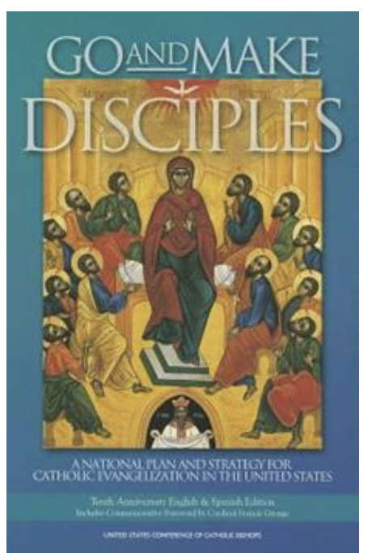

What is strange about these books?

Slide 9
Their Titles are Incomplete
Matthew 28:18-19 - Then Jesus came to them and said, “All authority in heaven and on earth has been given to me. Therefore, go and make disciples of all nations, baptizing them in the name of the Father and of the Son and of the Holy Spirit,
Notes:
Evolution of modern Christianity
Become a Disciple not just a Christian
Of all nations
Right now <5% of evangelical churches are multiracial
In the spirit of family
In the spirit of Homothumadon

Slide 10



Slide 11

Homogeneous
Why didn’t they just separate into 2 churches, Jewish and Gentile?
That would solve a lot of problems
They could even meet together on occasion. Heis
One church could sing Gadol Elohai (How great is our God) while the other sang the Oxyrhynchus hymn
Notes:
When we look at the Biblical Text

Slide 12
Do Individual Churches Have to be Diverse?
The Council at Jerusalem
Acts 15
Certain people came down from Judea to Antioch and were teaching the believers: “Unless you are circumcised, according to the custom taught by Moses, you cannot be saved.”

Slide 13

Gary Coleman – Whatcha Talkin’ Bout Willis

Slide 14
Number of verses where Paul teaches the disciples about the gathering of the nations or trains them in cross-cultural life together.
637

Slide 15
Heterogeneous
At every opportunity, the apostolic church described in the New testament rejected separation and homogeneity because they understood that they must be the visible display of God’s great project to gather the nations.

Slide 16
Common objections to FOCUSING on CULTURE
“We must let the Bible dictate our approach to culture rather than culture dictate how we approach Scripture”
Gal 1:8
  But even if we or an angel from heaven should preach a gospel other than the one we preached to you, let them be under God’s curse!
II Cor 1:12
  Now this is our boast: Our conscience testifies that we have conducted ourselves in the world, and especially in our relations with you, with integrity and godly sincerity. We have done so, relying not on worldly wisdom but on God’s grace.
Romans 12:2
  Do not conform to the pattern of this world, but be transformed by the renewing of your mind. Then you will be able to test and approve what God’s will is —his good, pleasing and perfect will.
Notes:
It depends on how you look at it

Slide 17
What is Culture
Culture can be defined as the abstract, learned, shared rules and standards for generating behavior and understanding experience
Notes:
How are we going to reach homothumadon as a multicultural church
SO THAT THE WORLD MAY KNOW?

Slide 18
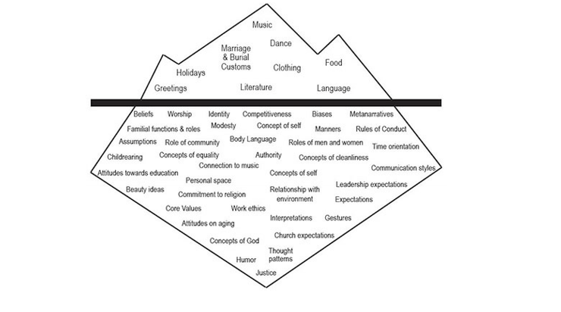
Notes:
Tell the story of the uninvited guest

Slide 19
UNIVERSAL SIN
WORDLY SIN
#3
#2
Culture
#1
Life Of
Christ
Truth
NEUTRAL
Ideology
#4
Notes:
Keeping in mind the definition of culture
Values, beliefs, traditions
Neutral
How many meals you eat a day
How do you view the uninvited guest?

Slide 20
How do we become all things to all people
Step 1: Become familiar with our own cultural practices and preferences
Step 2: To be all things to all people we must be willing to give up our rights and preferences for the benefit of others
Step 3: We must become a student of other cultures
  We do not need a PhD, but we should be willing to maintain an awareness and sensitivity to the dynamics of culture and be receptive to learning from others
Step 4: Intentionally bring ourselves to a state of cultural flexibility

Slide 21
Some of the topics we will have to confront will seem overwhelming
Race
Politics
Income inequality
Gender
Views of authority
Eastern vs Western styles of culture
Roles of church leadership

Slide 22

GRACE

Slide 23
Hospitality
It is not just a good idea; it is a biblical principle and is demanded of God’s people (Romans 12:13; Hebrews 13:2; 1 Peter 4:9; 3 John 1:8).
Around the table we can laugh, talk, cry, get to know one another, and learn the value of one another’s culture.

Slide 24
Unity and Diversity Team
David Bryant
Caryn Bryant
Charissa Hicks
Mark Johnson
Gary Nealon
Alex Smith
Josh Stoner

