Slide 1
WORSHIP 101

Slide 2
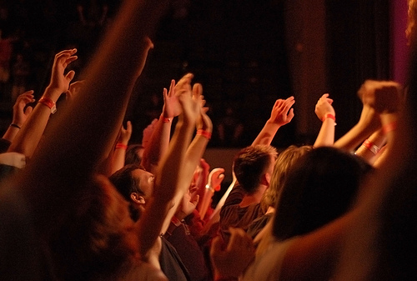
WORSHIP

Slide 3
OUR CHURCH CULTURE
We are biased by our own church culture:
We have 200 years of acapella music
We are Bible centric
We emphasize commitment
We are fellowship driven

Slide 4
OUR CHURCH CULTURE
We admire evangelistic enthusiasm
We teach openness and repentance
We have a specific vernacular:
Quiet Times, D-times, Friday Devo, Small Groups, Family Groups, Regions, brother, sister, mentor, discipler, weasel dates, encouragement dates, door knocking, etc.

Slide 5
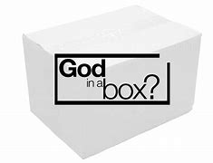
WORSHIP IN A BOX
WORSHIP is:
When I listen to Contemporary Christian music
Sunday church

Slide 6
Worship Defined
The English word “worship” comes from the Anglo-Saxon (400-600 AD) weorthscipe which meant to ‘ascribe worth’.
The word was later modified to worthship.
If you’re a French Canadian citizen addressing the mayor, you would say, “Your worship” to show honor and respect.

Slide 7
Worship Defined
It honors God
It is directed towards God
It requires involvement on the part of the worshiper.

Slide 8
Worship Defined
But the enemy wants me to:
Focus on my difficulties and problems
Feel distant from God
Be distracted and not participate with my heart

Slide 9
Worship Defined
JEREMIAH 32:39-40
God says, “And I will give them one heart and one purpose: to worship me forever, for their own good and for the good of all their descendants. And I will make an everlasting covenant with them: I will never stop doing good for them. I will put a desire in their hearts to worship me, and they will never leave me.”

Slide 10
Worship thru Life
I’m not ready to worship.
I don’t feel worthy enough to worship.
I don’t feel like participating.
Did you immediately think I was talking about Sunday service or life in general?

Slide 11
Worship thru Life
Our LIFE is very much like the PSALMS:
1/3rd are Psalms of Orientation
1/3rd are Psalms of Disorientation
1/3rd are Psalms of Reorientation
2 out of every 3 days we aren’t quite oriented with God

Slide 12
Worship thru Life
ACTS 16:25-26
About midnight Paul and Silas were praying and singing hymns to God, and the other prisoners were listening to them. Suddenly there was such a violent earthquake that the foundations of the prison were shaken. At once all the prison doors flew open, and everyone’s chains came loose.

Slide 13
Learn to Worship
EPHESIANS 1:11-12
In him we were also chosen, having been predestined according to the plan of him who works out everything in conformity with the purpose of his will, in order that we, who were the first to hope in Christ, might be for the praise of his glory.
Be what?

Slide 14
Learn to Worship
JOHN 4:22-24 - You Samaritans worship what you do not know; we worship what we do know, for salvation is from the Jews. Yet a time is coming and has now come when the true worshipers will worship the Father in the Spirit and in truth, for they are the kind of worshipers the Father seeks. God is spirit, and his worshipers must worship in the Spirit and in truth.”

Slide 15
Learn to Worship
PSALM 89:15-16
Blessed are those who have learned to acclaim you, who walk in the light of your presence, O Lord. They rejoice in your name all day long; they exult in your righteousness.
Acclaim = celebrate, praise, admire, revere, honor
Exult = to show or feel elation or jubilation, to rejoice

Slide 16
Expressions of Worship
10 HEBREW WORDS
Rum = exalt = to be high, to rise or raise
Halal = hallelujah = praise the Lord, expend energy
Todah and yadah = extend the hands, adore, praise
Gheel = to spin around, rejoice, be glad
Shachah = prostrate, homage to royalty, bow down
Hagah = imagine, meditate, mourn
Zamar = to touch the strings or parts of a musical instrument
Raw-nan = to shout, high energy
Patsach = to break out in joyful sound, high energy
All these WORSHIP WORDS are found throughout the Bible!

Slide 17
Summary of Worship
Worship is about ascribing worth to God.
Worship begins with your heart.
Worship must be learned.
Worship must be actively pursued.
Worship must be expressed.
Worship during oriented, disoriented, and reoriented phases in life.

